Slide 1

SCALES AND RELIABILITY ANALYSIS
WELLNESS AND LIFESTYLE DATA
10/16/2023
MICHAEL OPPONG

Slide 2
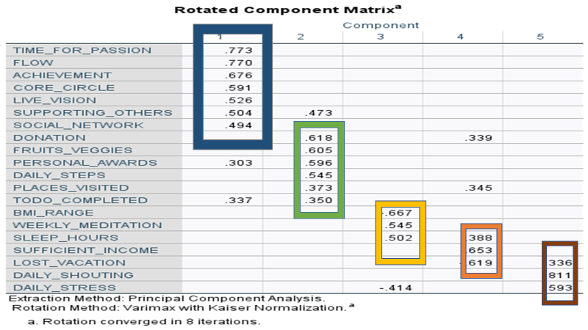
Conclusions- Constructs from Factor Analysis
Self Actualization
Self Esteem
Safety &Security
Physiological Needs
Love &Belonging

Slide 3
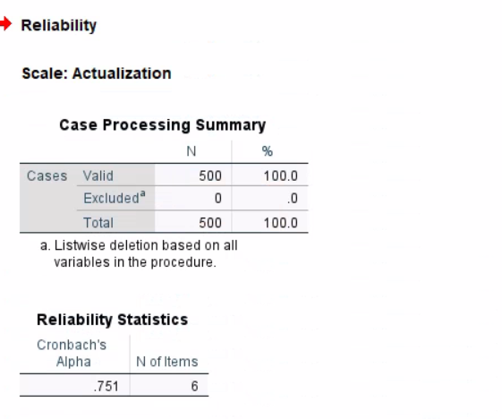
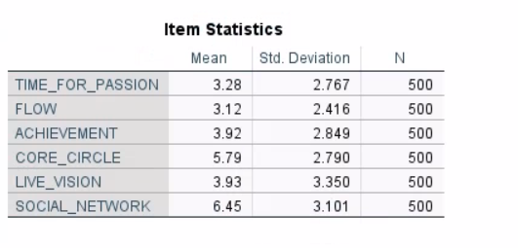
Cronbach’s Alpha for Construct 1- Self Actualization

Slide 4
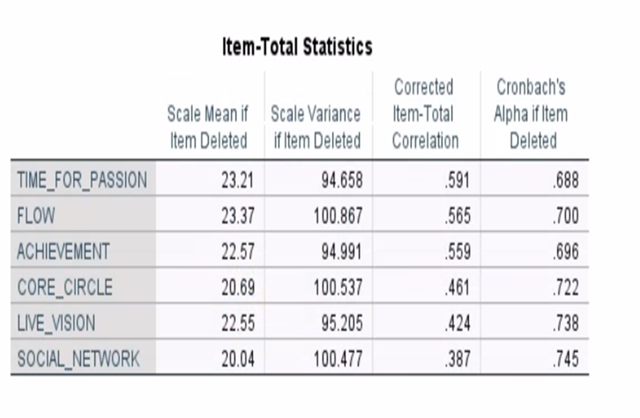
Justification for Cronbach’s Alpha for Construct 1

Slide 5
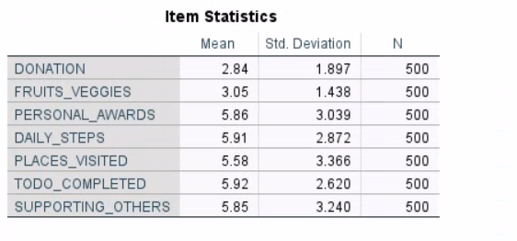
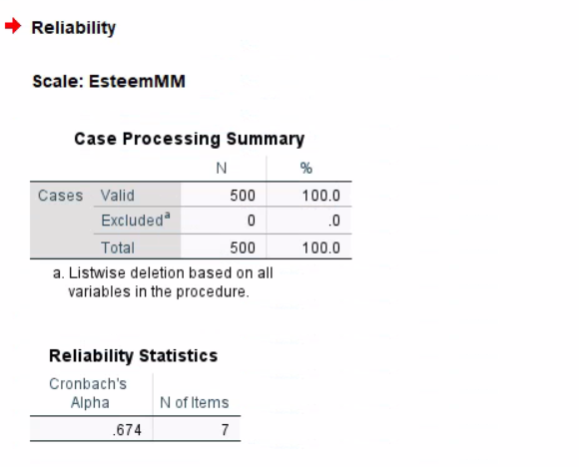
Cronbach’s Alpha for Second Construct - EsteemM

Slide 6
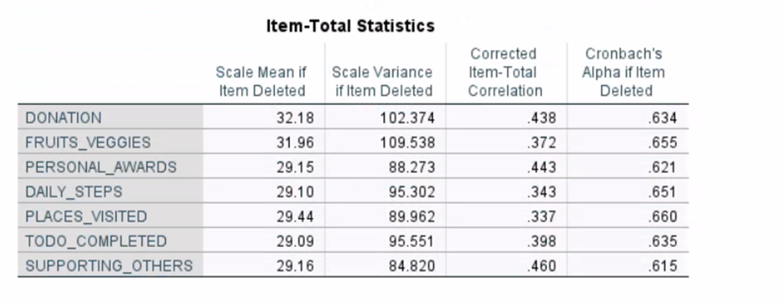
Justification for 2nd Construct

Slide 7
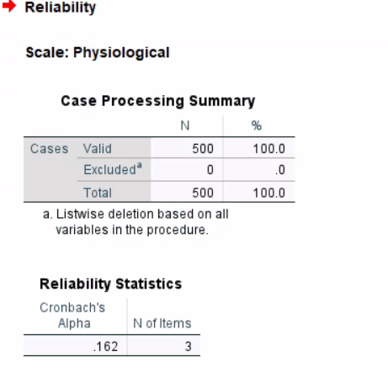
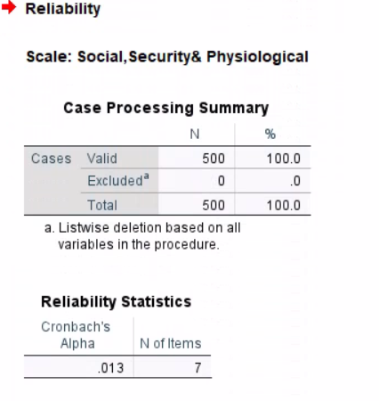
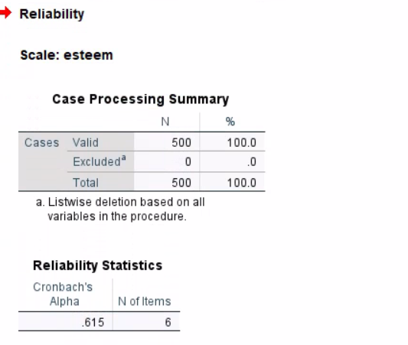
Adjustments In Constructs for Cronbach’s

Slide 8
Conclusion
Using reliability analysis you can determine the extent to which items in your questionnaire are related to each other and you can identify problem items that should be excluded from the scale.
It is deduced that the variables in Construct 1 is closely related referencing them to the Cronbach’s alpha.

